Slide 1
UNDERSTANDING REQUIREMENTS MODELING

Slide 2
Objective
Analyze a problem by using business and system modeling
Model requirements by using use cases and actors

Slide 3
Creating Use Case Diagrams for System Modeling
A use case diagram for system modeling describes:
The interaction between use cases and actors of the proposed software system.
The relationships, such as associations and generalizations, existing between use cases and the actor.

Slide 4
Creating Use Case Diagrams for System Modeling
The information that a use case should contain is:
Name
Summary
Basic course of events
Alternative paths
Exception paths
Triggers
Assumptions
Preconditions
Post conditions
Business rules
Authors
Date

Slide 5
Name: Indicates a unique identification of the use case. For example, you can name a use case as Give Appointment.
Summary: Indicates the functions provided by the use case.
Basic course of events: Indicates the steps of interaction that occur between the actor and the software system to achieve the functions described in the use case. For example, the actor initiates the process and then the system responds.
Alternative paths: Describe the situations in which an uncommon condition occurs.
Exception paths: Describe the interactions that occur between a use cases and an actor when an error occurs.
Triggers: List the conditions that must occur to make an actor initiate a use case. Triggers describe a business need, time-related event, or the output of another use case.
Assumptions: Specify the conditions that should be true to make the system work. You make these assumptions to make the design of the system relatively simpler.
Preconditions: List the conditions that must occur before the interaction between the use case and an external entity begins. Preconditions are outside the scope of the use case and the software system.
Post conditions: List the conditions that are satisfied when the use case is completed. Post conditions are a part of the contract between this use case and the outside world.
Business rules: List the business rules that relate to the requirements presented in the use case.
Authors: Specify the name of the author.
Date: Contains the date on which the use case was originally written with references to when it was changed.

Slide 6
Creating Use Case Diagrams for System Modeling
System actors are external entities that interact with the software system and affect the system functionality.
System actors can be classified as:
Primary actors: Directly interact with the system and initiates the use case.
Secondary actors: Do not directly interact with the system but can initiate interaction of a primary actor with the system.

Slide 7
Creating Use Case Diagrams for System Modeling
The relationship among actors represents their interaction with other actors and use cases.
The various types of relationships that exist among actors are:
Generalization relationship: Exists among actors that have similar behavior and similar properties.
Association relationship: Shows the communication path between the use case and the actor.
Association is represented using an arrow or a simple line.
The arrow show the direction of communication and the line indicates that the communication is occurring in both the directions.

Slide 8
Identifying System Boundary
To identify system boundary:
Prioritize use cases of the system.
Identify iterations for developing the system.
Identify the interaction between use cases and actors of each iteration.
You represent the system boundary using a rectangular box around the use cases in the use case diagram.

Slide 9
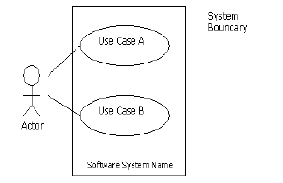
Contoh

Slide 10
Establishing Project Scope
Establishing project scope before implementing the project ensures that all the
requirements of the project are fulfilled in time and with the available
resources.
• Functions of project scope are:
• Project functionality
• Project resources
• Available time
• To establish a project scope:
• Identify the requirements of the system.
• Set priorities for the requirements to identify successive iterations.
• Assess the efforts required to implement the requirements.
• Analyze the impact of implementing each requirement of the system.

Slide 11
Refining the System Definition
Use cases defined in the initial iterations of the development process may not be elaborate and specific due to inadequate information about the software system.
You need to refine software system definition to obtain detailed and specific information that enables you to design, code, and test the software system.
To refine the software system definition, you refine use cases and establish relationships among use cases.

Slide 12
Refining Use Cases
The steps to refine use cases are:
1. Review the actors of the use cases.
2. Review the names of the use cases.
3. Refine the description of the use cases.
4. Define and refine the flow of events.
5. Identify alternate paths.
6. Identify preconditions and post conditions.
7. Identify the non-functional requirements.

Slide 13
To refine use cases:
1. Review the actors of the use cases. This enables you to redefine the function of the actors to make the function more specific.
2. Review the names of the use cases. This enables you to rename the use cases to make them descriptive.
3. Refine the description of the use cases. This enables you to redefine the functions of the use cases to make the functions more specific.
4. Define and refine the flow of events. This enables you to accurately identify the flow of events for a use case.
5. Identify alternate paths. This enables you to identify the alternate flow of events that you may use to achieve the functions of a use case.
6. Identify preconditions and post conditions. This enables you to identify the conditions that must be true before the operation of a use case is triggered and the conditions that must be true after the operation of a use case is completed.
7. Identify the non-functional requirements, such as reliability and performance of a system.

Slide 14
Establishing Relationship among Use Cases
Relationships that can be established among use cases are:
Extend: Indicates that an existing use case is extended by additional behavior to obtain another use case.
Include: Indicates that the functionality of a use case is included in the functionality of another use case.

Slide 15
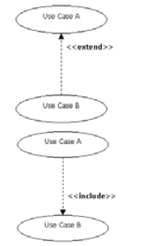
Establishing Relationship among Use Cases
Extend: Note that the direction of the
arrow in the extend relationship points
to the use case that is extended
to obtain another use case.
Include: Note that the direction
of the arrow in the include
relationship points to the
use case that is included
in another use case.

Slide 16
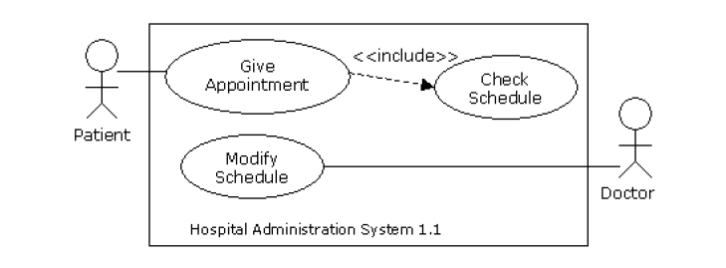
Refined Use Case Diagram for the First Iteration of the Hospital Administration System

Slide 17
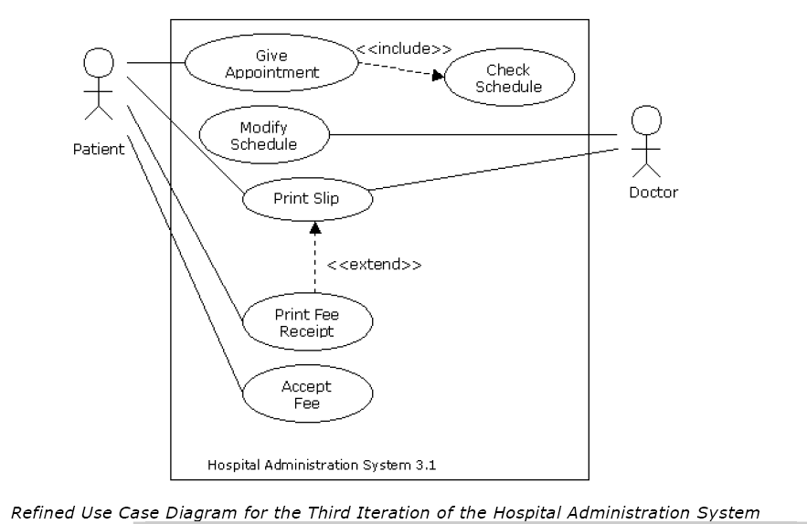
Contoh 1 ini kerjakan

Slide 18
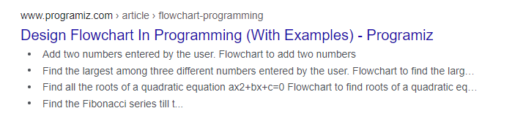
Contoh 2
Akses beberapa flowchart dari ini

Slide 19
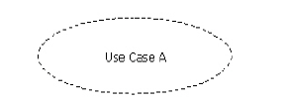
Realizing Use Cases in the Design Phase
Design phase requires understanding of how the functionality of a use case can be implemented using classes, interfaces, and sub-systems.
UML provides specific modeling constructs, known as collaboration, to model use case realizations in the design phase.
Collaboration is a collection of classes, interfaces, and sub-systems that interact with each other to accomplish the functionality of a use case.

Slide 20
Best Practices Naming Use Cases
A use case name should depict the functionality modeled using the use case.
Guidelines for naming a use case are:
Use customer terminology.
Specify briefly the working and description of the use case.
Use role names instead of end user titles to refer to roles.
• Depict the use case with clear distinction between input given to the use case and output of the use case.

Slide 21
Tips Setting Priorities of Use Cases
Setting use cases priority is an integral activity and involves identifying essential use cases of the software system that should be implemented in the first iteration.
Points to be considered while setting priorities are:
Priorities should be set without considering the technical or the
implementation aspects.
Priorities should be set to create a working software system, which provides the basic functionality, in a short span of time.
Priorities should be decided with the consent of end users, customers, and product managers.

Slide 22
SEKIAN

